Slide 1
Predicting NFL plays for the 2020-21 season
Shounak Rangwala
RUID: 191004996
netid:snr85

Slide 2
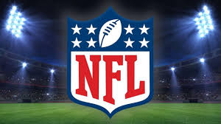

Introduction
NFL maybe the most lucrative sports league in USA. $8.1 billion revenue in total, approximately $225 million per team.
Annual cap: $198 million.
Results are everything: to fans and the investors/owners. Any tool to guarantee that will be welcome as long as it abides to NFL technology rules.
Eg. Chiefs broke their winning streak (fans) , Texans fires their coach (owner)
Analytics of the offensive plays has to be incorporated in decision making for all teams.

Slide 3
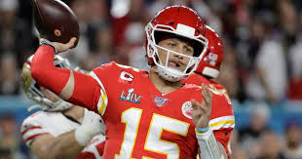
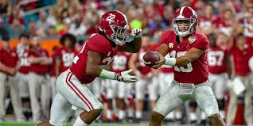
Concept - the 2 offensive plays
Pass
Quarterback throws the ball to a reciever
Classified as a “positive”/1 in my data
59.4% plays are passes
Advantages: more yards gained, quicker play, exciting af
Disadvantages: more likely to be intercepted
Run
Quaterback hands the ball to a player
Classified as “negative”/0 in my data
40.6% plays are runs
Advantages: high success probability to cover shorter distances
Disadvantages: susceptible to pretty much every defense formation

Slide 4
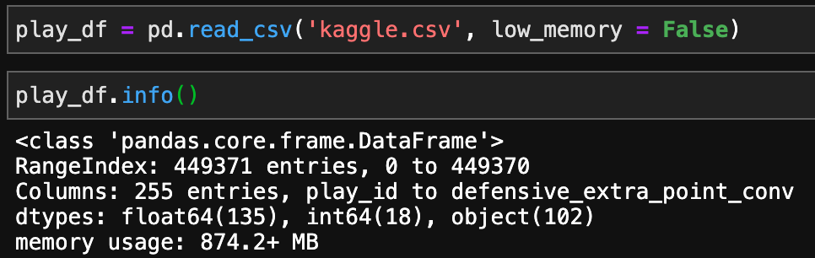
Data Source
Initially I had selected data from the nflsavant.com database for the project. The data however did not contain the essential metrics of time remaining in the game, in the quarter and in the half. It is common knowledge that professional teams rely on this parameter during the games to come up with plays and any model which was trained without these parameters would not be accurate.
Based on my literature review, the standard and most popular database for NFL plays is on Kaggle, created by Max Horowitz which has the plays data from the year 2009 to the year 2018. This is a huge dataset and the specifics of it are as follows:

Slide 5
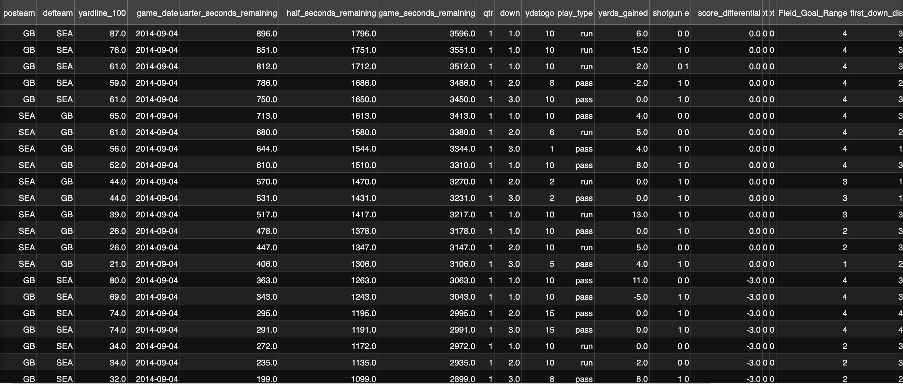

Slide 6
Literature Review
Ota, Karson L. Football play type prediction and tendency analysis. Diss. Massachusetts Institute of Technology, 2017. :
The author made explained certain technical terms related to football like “down”, “distance”, “score differential” and “field position”. These will be the key data attributes he used in making this predictive model. The paper discusses how important it is to make a “feature” vectors of values that are normalized between 0-1 to avoid scaling bias. Using this format of the data, they partitioned the dataset into training and test and carried out 2 different forms of predictions: aggregate and situational. The aggregate analysis tried to predict tendencies in the NFL as a whole. They used a neural network to predict the results of this analysis and also made a baseline model for comparison. Their model was better than the baseline by at least 10% score. A play would be influenced by the yardage remaining, or by the time remaining or by the field position. Using these attributes for a situational analysis, the researcher was able to distinguish between the tendency (which is the general assumption) and predictability (which is most favoured). The paper recognizes that while the increase in accuracy is significant, there is room for further improvement by incorporating more data and also by perfecting the encoding process for the data. By which they mean that the normalization of the data done at the very beginning could be done in ways that would make the predictions better.

Slide 7
Lit Review..........continued
Joash Fernandes, Craig, et al. "Predicting plays in the National Football League." Journal of Sports Analytics Preprint (2019): 1-9.
The researchers here highlight that previous papers while focusing on coming up with models with good accuracy do not pay attention to the false negative parameter of their results. The paper reasons that the false negative would be the case where the model predicts a run instead of a pass and the defense that would be set up for a pass can also be used to stop a run but not vice-versa. The first part of the paper deals with using various complex models like neural networks, k-nearest neighbours, random forests and classification trees to get the model that will give them the highest prediction accuracy and the lowest false negative rate. After running multiple analysis, they settle on a neural network model that provides 75% accuracy and false negative rate of about 10%. In the tradeoff between simplicity and accuracy, they finalized upon a decision tree model with a 65% accuracy which corresponds to an 85% accuracy on their baseline neural network. This tree uses only 3 variables: “down”, “yards to go” and “point difference”. A possible extrapolation of this tree to specific teams is also discussed in the paper. When facing a specific team, we can use a new attribute of “formation” and predict accurately with an average accuracy of 73%.

Slide 8
Lit review............. continued
Teich, Brendan, Roman Lutz, and Valentin Kassarnig. "NFL Play Prediction." arXiv preprint arXiv:1601.00574 (2016).
The paper revolves around the possibility of finding this holy grail of a model. The focus of this paper is not to produce a practical model that will be used in the actual game, it focusses more on comparing and contrasting different models. The paper suggests using the F1 score which takes into consideration both recall and precision. They also have a unique take on the data output which happens through a function where the number of the current down, the number of yards gained in the play and the number of yards needed for a firstdown/touchdown are used. They then go on to perform analysis through several complex models such as classification trees, regression trees, Nearest centroid, linear discriminant analysis, support vector machine and neural networks. The performance of these models was evaluated based on their accuracy, precision and recall. They also believe that recall, precision and accuracy all the 3 have to compared to judge the best model. Judging solely by accuracy will not help us address the false positives that will be predicted by the model.

Slide 9
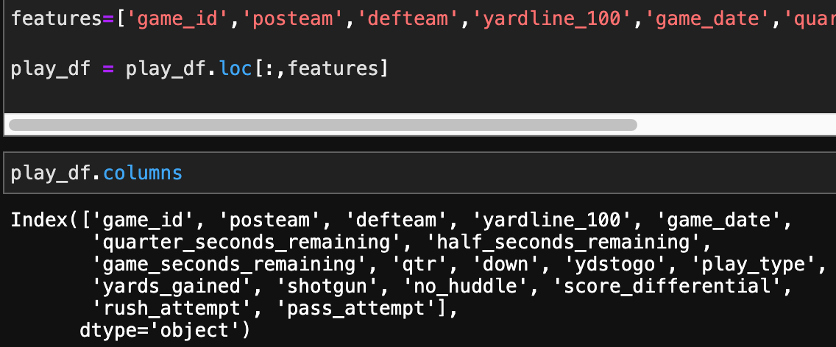
Cleaning/Preprocessing
Since there are almost 255 columns we need to select only the features we think are most essential. Also we don’t need data from earlier years and so to maintain relevancy in the model I selected the last 5 years worth data (2014-2018 seasons). I selected these columns/attributes:
Next steps: removing null values, renaming teams which have shifted franchises, add some more features

Slide 10
Cleaning... continued
The kind of plays include pass, run, kickoff, punt, field goal etc. We are only interested in ‘pass’ and ‘run’ plays for our model and so we drop the other records from the data. Next, we search for null values in all columns and luckily, we had only 400 null values in the total dataset which would be insignificant against the 158600 records we have. So, I removed all the records with null values.
Teams needed to be renamed: The St. Louis Rams had since moved to Los Angeles and had become the LA Rams. The San Diego Chargers had moved to LA to become the LA Chargers. The some LA Rams records were misspelled and had to be corrected. Some Jacksonville records were misspelled and had to be corrected. This is important because we will be encoding the categorical attribute of offensive team names for our model and need uniformity in the data.

Slide 11
Preprocessing.....continued
We added a couple of extra features that may be impactful in the decision making of the plays. The yards_to_first_down range and the field_goal _distance range. We divided the actual yards distance into ranges which would be used by coaches in a broad view to call plays. Eg. The play called at 3 yards won’t be different from the one called at 4 yards.
Also the type of play called may be decided if they can get within a certain range to be able to make the field goal since that would give them the necessary points to take a lead or maybe just to get points so that may be an important factor. So this too is split into different ranges.
Lastly, we use the LabelEncoder() to encode the names of the teams and also encode the run plays as 0 and pass plays as 1

Slide 12
PART - 1 Tendency models
Traditional statistical analysis of the data. This is what is currently used in the traditional play calling in the league right now because this is based on analysis of the historical data without any kind of prediction.
Due to the way the game is played, there exist some tendencies in the league (in general) as well as specific to the teams that play the game.
I used the features of “down” and “yards_to_first_down” range to break up the number of pass and run plays in that situation so that we can see what is statistically preferred (aka. The tendency of the team).
The following are some of the results.

Slide 13
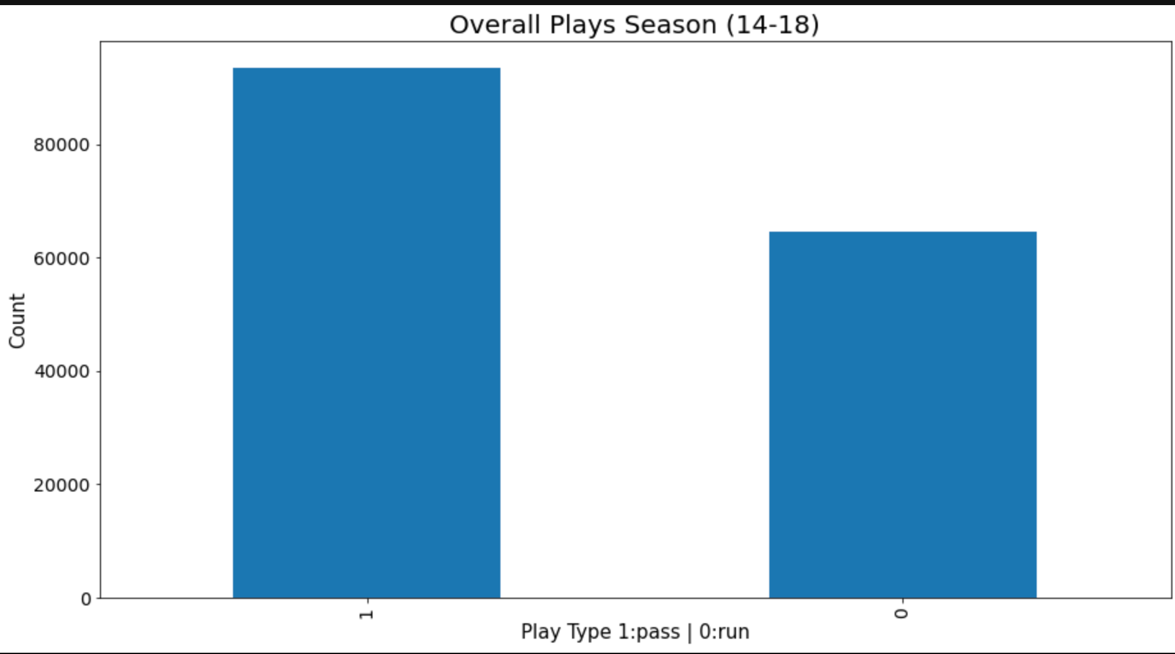
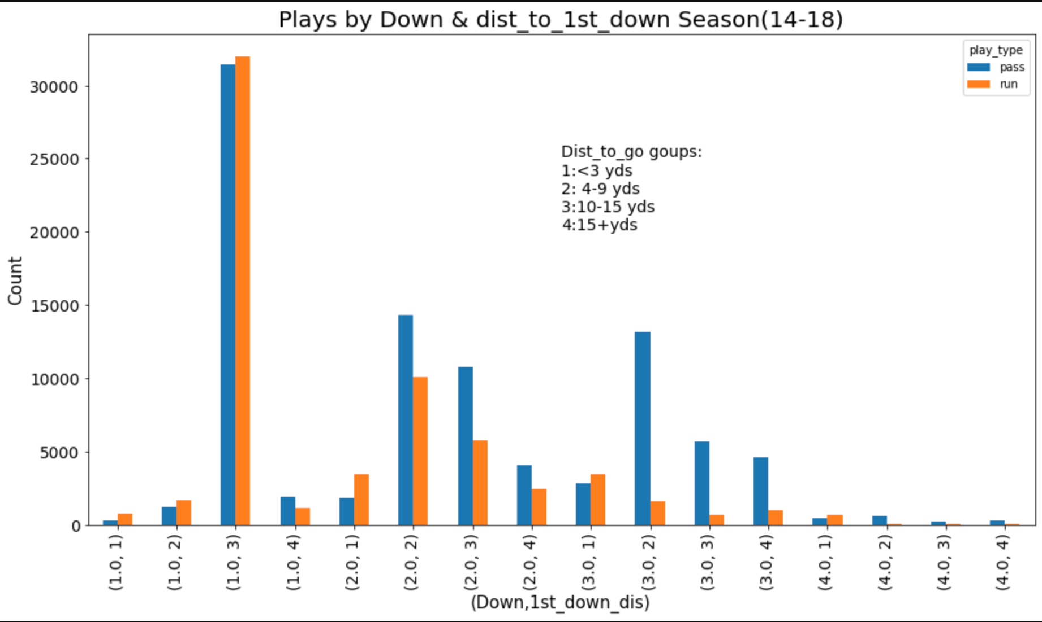
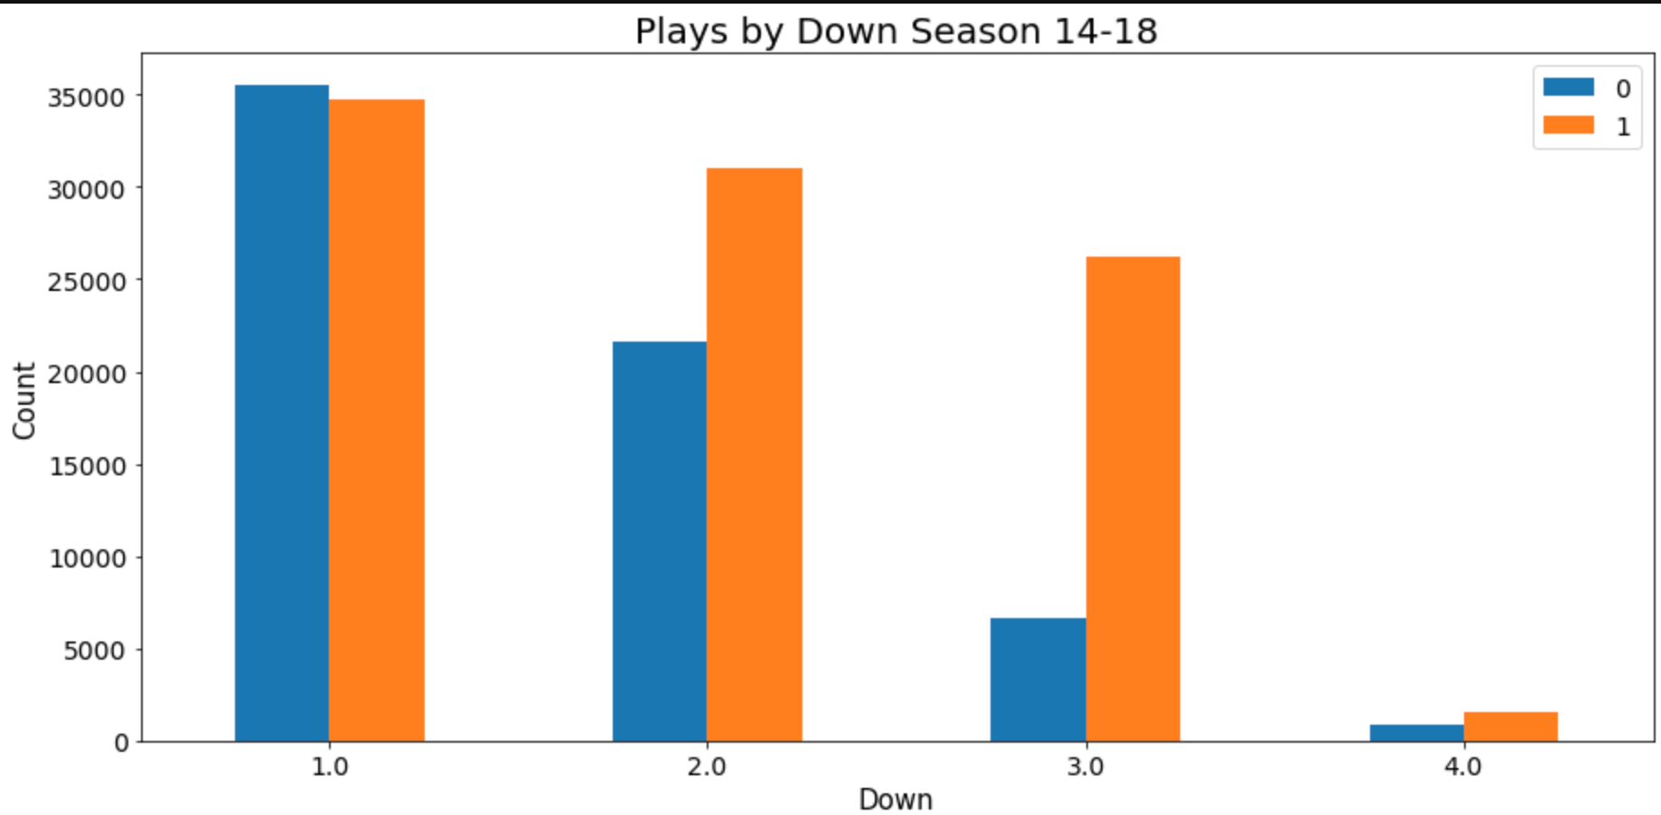

Slide 14
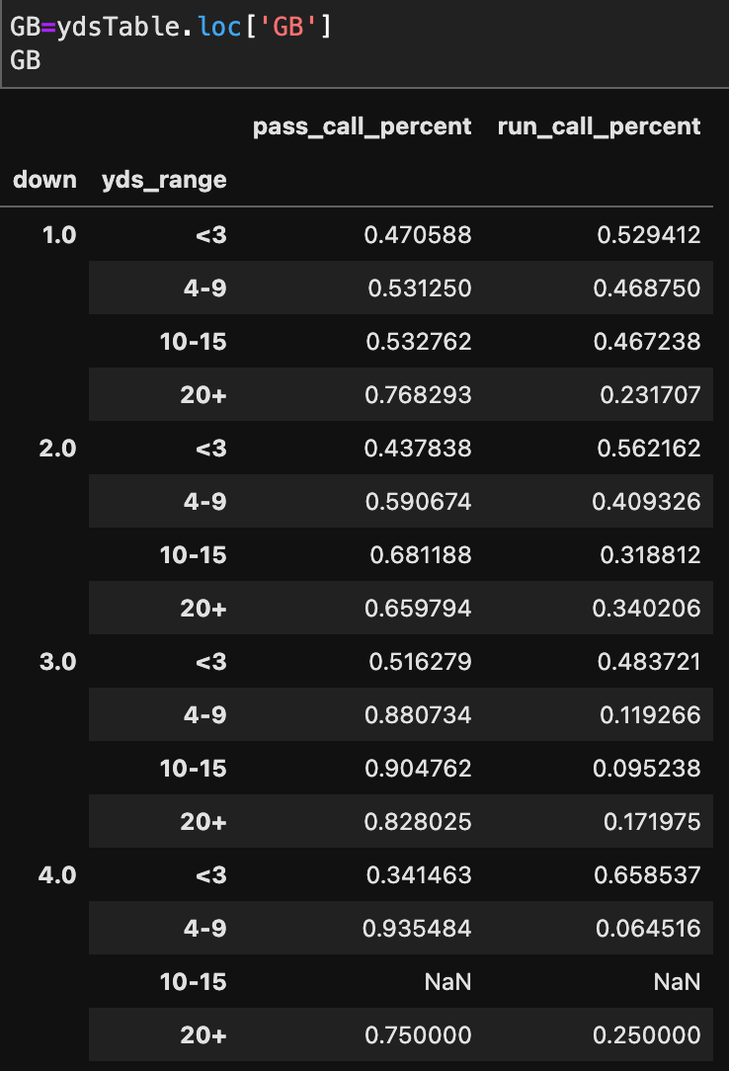
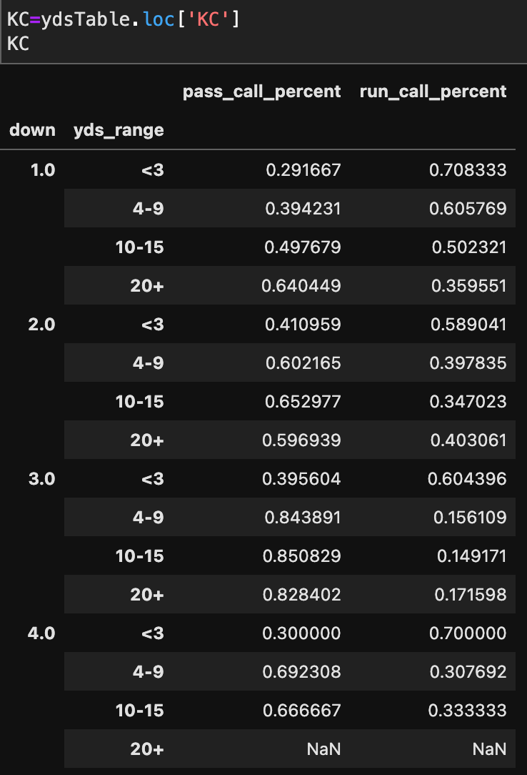

Slide 15
PART – 2 Predictive Models
Baseline model: Predict pass play each time (59% accuracy)
We want the ‘best’ predictive model and so we decided to make the following models:
Logistic Regression
Logistic Regression with ridge classifier
Neural Network
KNN Classifier
Random Forest Classifier
Gradient Boosting Classifier

Slide 16
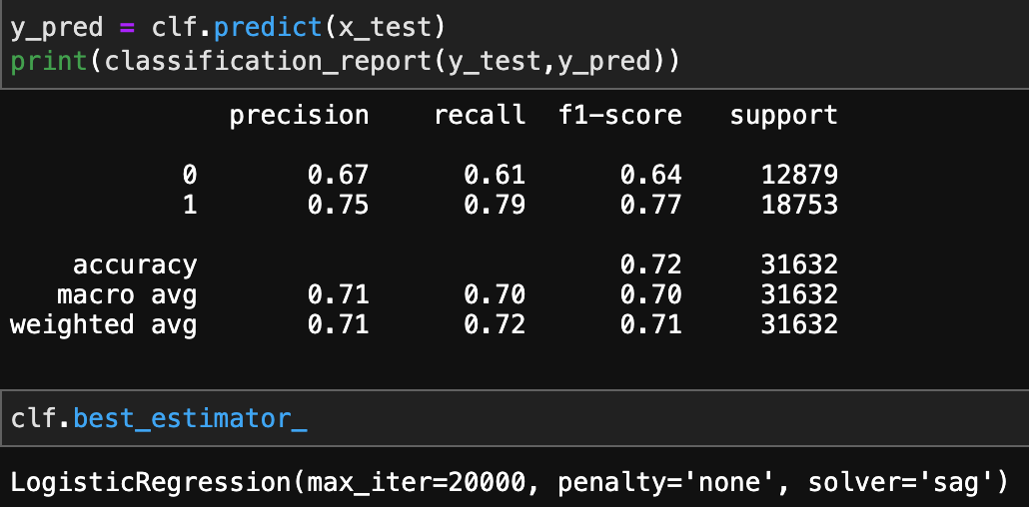
Logistic Regression

Slide 17
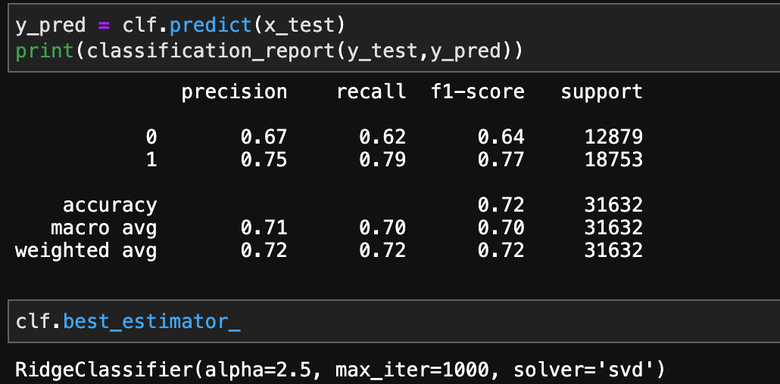
Logistic Regression with Ridge classifier

Slide 18
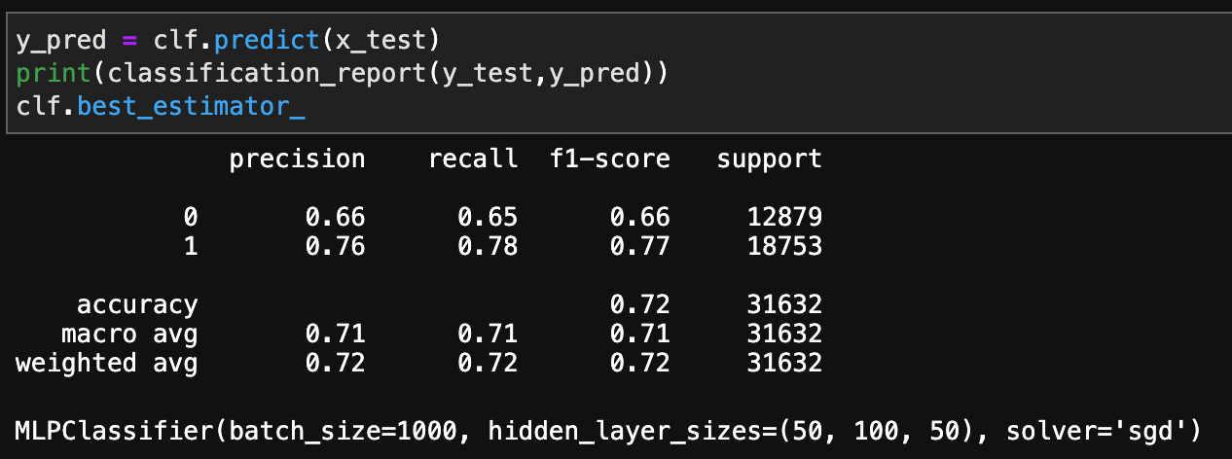
Neural Network

Slide 19
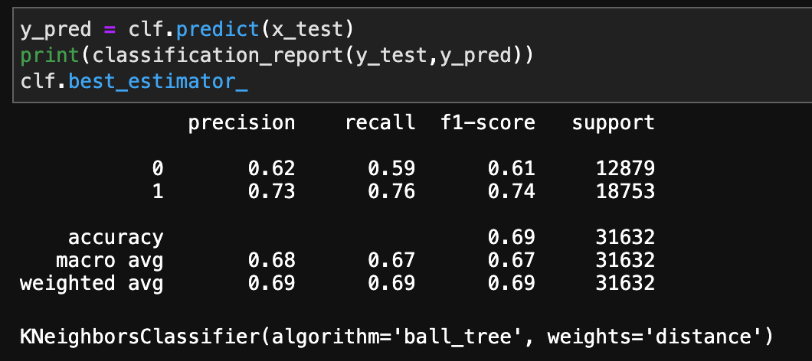
KNN Classifer

Slide 20
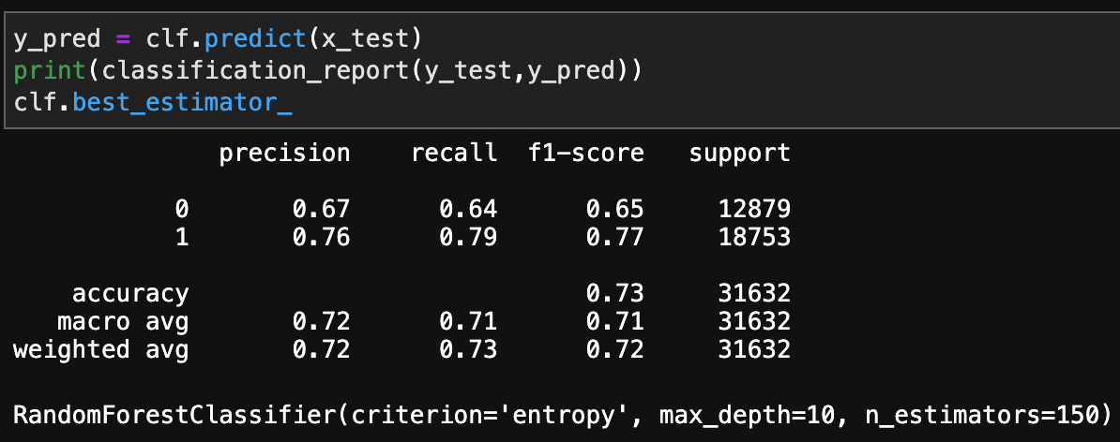
Random Forest Classifier

Slide 21
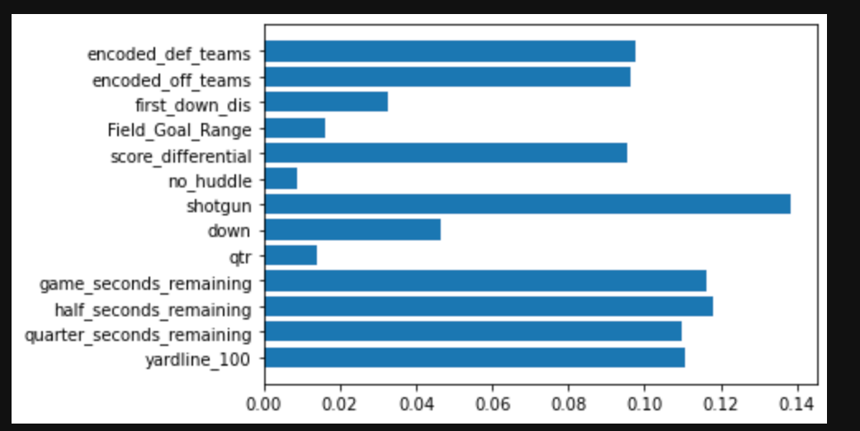
Random Forest......continued

Slide 22
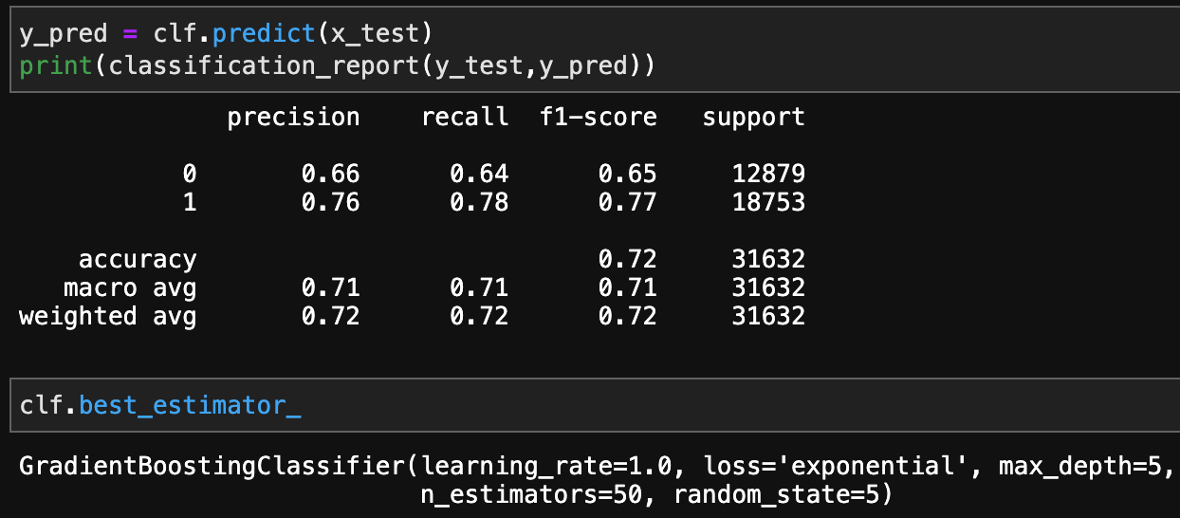
Gradient Boosting Classifier

Slide 23
Discussions/Conclusion
Accuracy wise: Random forest classifier was marginally better than the rest.
Recall wise : Neural network was the one with the best recall.
Significance of recall: predicting a pass play when a run play is the actual value/ predicting a run play when the actual value is a pass play. This is where the judgement of the coach comes into play. How well can the defense adapt to a wrong prediction?
Ideally, a model with more accuracy and good recall: in this case the neural network will be the ideal with tradeoffs between these 2 metrics.

Slide 24
Time Log
10/14 3:00 - 5:00pm – Literature review....................................................................2 hrs
10/16 5:00 – 7:00pm – Literature review....................................................................2 hrs
10/17 6:00 – 10:00pm – Proposal and presentation...............................................4 hrs
11/4 6:00– 11:00pm – Data source finding.................................................................5 hrs
11/6 6:00 – 10:00 pm - Data cleaning...........................................................................4 hrs
11/13 6:00 – 10:00 pm – Data preprocessing.............................................................4 hrs
11/22 3:00 – 9:00 pm – Tendency models....................................................................6 hrs
11/29 2:00 – 10:00 pm – Predictive models................................................................8 hrs
12/5 1:00 – 8:00 pm – Testing/changing parameters/ getting graphs .............7 hrs
12/6 4:00 – 7:00 pm - Presentation making................................................................3 hrs

Slide 25
Thank you.

